Slide 1
IoT Architectures & Communication Protocols
Eng. NIYITEGEKA JANVIER
jniyitegeka@iprctuba..rp.ac.rw
IPRC TUMBA

Slide 2
Part 1: IoT Architectures

Slide 3
Session Agenda:
Components of IoT System
General IoT Architecture
Three Layers architecture
Five Layers architecture
Cloud based architecture
Challenges of cloud based architecture
Edge Based and Fog Based architecture
Technologies enabling Fog technology

Slide 4
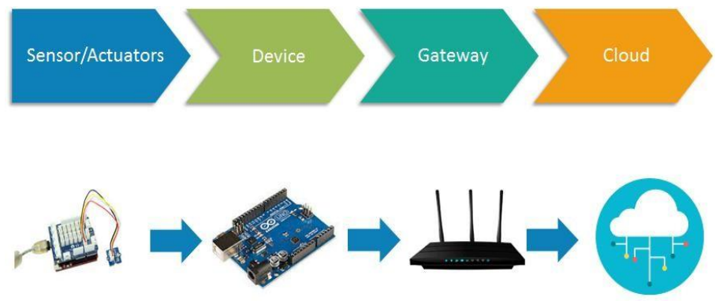
Basic components of an IoT System
IoT architecture consists of different layers of technologies supporting IoT.
There is no single consensus on architecture for IoT, which is agreed universally.
Different architectures have been proposed by different researchers.
IoT architecture varies from solution to solution, based on the type of solution which we intend to build.

Slide 5
IoT Architecture

Slide 6
Sensors & Actuators
Sensors collect data from the environment or object under measurement.
Actuators can intervene to change the physical conditions that generate the data.
An actuator might, for example, shut off a power supply, adjust an air flow valve, or move a robotic gripper in an assembly process.

Slide 7
DEVICE
Combine Hardware and software that directly interact with the world.
Devices connect to a network to communicate with each other.
Device that communicates with centralized applications.
Devices might be directly or indirectly connected to the internet.

Slide 8
GATEWAY
Enables devices that are not directly connected to the Internet to reach cloud services.
Although the term gateway has a specific function in networking, it is also used to describe a class of device that processes data on behalf of a group or cluster of devices.
The data from each device is sent to Cloud Platform, where it is processed and combined with data from other devices.

Slide 9
Con’d
A gateway manages traffic between networks that use different protocols.
A gateway is responsible for protocol translation and other interoperability tasks.
An IoT gateway device is sometimes employed to provide the connection and translation between devices and the cloud.
A gateway device acts as a proxy, receiving data from devices and packaging it for transmission over TCP/IP.

Slide 10
Cont’d
A gateway is dedicated to the device that:
Don't have the electrical power to perform required network transmission.
Don’t have processing capability needed for transport-layer security (TLS), and as such can't communicate with Google APIs.
Don’t have routable connectivity to the Internet, for example, Bluetooth devices.

Slide 11
Cont’d
A gateway device might be used even when the participating devices are capable of communicating without one.
In this scenario, the gateway adds value because it provides processing of the data across multiple devices before it is sent to the cloud.
In that case, the direct inputs would be other devices, not individual sensors.

Slide 12
Gateway Tasks
Condensing data to maximize the amount that can be sent to the cloud over a single link
Storing data in a local database, and then forwarding it on when the connection to cloud is intermittent
Providing a real-time clock, with a battery backup, used to provide a consistent timestamp for devices that can't manage timestamps well or keep them well synchronized
Performing IPV6 to IPV4 translation
Acting as a local cache for firmware updates

Slide 13
IoT cloud platform
After your IoT project is up and running,
You need an efficient, scalable, affordable way to both manage those devices and handle all that information and make it work for you.
When it comes to storing, processing, and analyzing data, especially big data, it's hard to beat the cloud.

Slide 14
Cloud Platform
Sensor Grid
Sensor
Client Application Enterprise App
Notify
Publish
Publish
IoT Cloud
Control
Subscribe()
Notify()
Unsubscribe()
Sensor
Notify
Client Application Desktop Client
Sensor
Publish
Notify
Client Application Web Client

Slide 15
IoT Models
The common feature that can be derived from all the architectures mentioned above, is that they have well-defined boundaries for different activities clustered into layers.
The layers can be adopted by different technologies, components, brands and so on.
Physical devices: The “things” in the IoT
The gateway: A border module to link resource-limited devices
Integration: A protocol to allow communication between nodes and servers
Applications: Data processing and analytics, for example

Slide 16
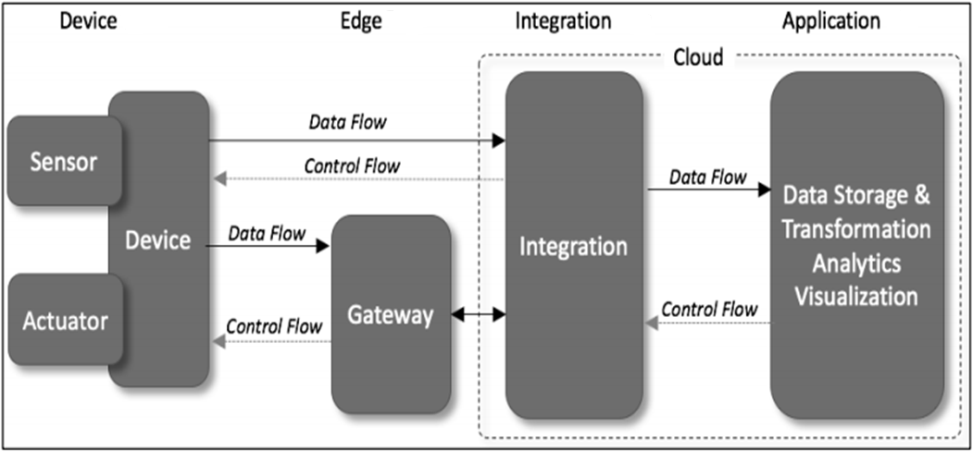

Slide 17
Layer 1 – Physical Layer (Device Layer)
Sensors are used to capture parameters about the environment and to convert those into electrical signals.
Actuators are used for the process of automation to perform any physical action.
Communication between the devices and servers can happen in two ways(direct or via gateway).

Slide 18
Layer 2 – Gateway Layer
Gathering of data from various devices is the main requirement.
It performs translation of various messages received from heterogeneous devices.
it can provide services like data filtering, cleanup, aggregation and packet content inspection.

Slide 19
Layer 3: Integration Layer
Most of the time this layer is hosted in the cloud
This layer would be responsible for the collection of data from the gateways and storing in such way that they can be queried and processed.

Slide 20
Layer 4 - Application Layer
The Application Layer is responsible for the presenting the data collected, storage, processed and labelled in such a way that it hides the complexities and is more inductive to users.

Slide 21
General IoT Architecture
IoT architecture consists of different layers of technologies supporting IoT.
It serves to illustrate how various technologies relate to each other and to communicate in different scenarios.

Slide 22
General IoT Architecture

Slide 23
a) Smart device / sensor layer:
The lowest layer is made up of smart objects integrated with sensors.
The sensors enable the interconnection of the physical and digital worlds allowing real-time information to be collected and processed.
The sensors have the capacity to take measurements such as temperature, air quality, speed, humidity, pressure, flow, movement and electricity etc.

Slide 24
Cont’d
Most sensors require connectivity to the sensor gateways.
This can be in the form of a Local Area Network (LAN) such as Ethernet and Wi-Fi connections or Personal Area Network (PAN) such as ZigBee, Bluetooth etc.
For sensors that do not require connectivity to sensor aggregators, their connectivity to backend servers/applications can be provided using Wide Area Network (WAN) such as GSM, GPRS and LTE.

Slide 25
b) Gateways and Networks
Massive volume of data will be produced by these tiny sensors and this requires a robust and high performance wired or wireless network infrastructure as a transport medium.
Various gateways (microcontroller, microprocessor...) & gateway networks (WI-FI, GSM, GPRS...) are available.

Slide 26
c) Management Service Layer
The management service renders the processing of information possible through analytics, security controls, process modeling and management of devices.
One of the important features of the management service layer is the business and process rule engines.
The rule engines support the formulation of decision logics and trigger interactive and automated processes to enable a more responsive IoT system.
Security of the system prevents system hacking and compromises by unauthorized personnel, thus reducing the possibility of risks.

Slide 27
d) Application Layer
It defines various applications in which the Internet of Things can be deployed, for example, smart homes, smart cities, and smart health. such as: Transportation, Building, City, Lifestyle, Agriculture, Factory, Supply chain, Emergency, Healthcare, User interaction, Culture and tourism, Environment and Energy.

Slide 28
Three- and Five-Layer Architectures

Slide 29
Three-Layer Architecture
The perception layer is the physical layer, which has sensors for sensing and gathering information about the environment.
The network layer is responsible for connecting to other smart things, network devices, and servers. Its features are also used for transmitting and processing sensor data.
The application layer is responsible for delivering application specific services to the user. It defines various applications in which the Internet of Things can be deployed, for example, smart homes, smart cities, and smart health.

Slide 30
Five-Layer Architectures
Another is the five-layer architecture, which additionally includes the processing and business layers.
The five layers are perception, transport, processing, application, and business layers. The role of the perception and application layers is the same as the architecture with three layers.

Slide 31
Cont’d
The transport layer :transfers the sensor data from the perception layer to the processing layer and vice versa through networks such as wireless, 3G, LAN, Bluetooth, RFID, and NFC.
The processing layer:is also known as the middleware layer. It stores, analyzes, and processes huge amounts of data that comes from the transport layer.
The business layer: manages the whole IoT system, including applications, business and profit models, and users’ privacy.

Slide 32
Cloud and Fog Based Architectures

Slide 33
Cloud Based Architecture
These architectures are related to the nature of data processing.
In some system architectures the data processing is done in a large centralized fashion by cloud computers.

Slide 34
Cloud computing
Practice of using a network of remote servers hosted on the Internet to store, manage, and process data, rather than a local server or a personal computer(cloud computing)
A general term for anything that involves delivering hosted services over the Internet
Service models: Software as a Service - SaaS; Platform as a Service – PaaS; Infrastructure as a Service - IaaS

Slide 35
Challenges
Centralized architecture
Result in high latency
Explosive growth in various access devices and end user demands
The number of devices connected to IoT will continue to be increased
IoT applications generate enormous amounts of data by IoT sensors.

Slide 36
Challenges
Resource-constrained devices
uninterrupted services with intermittent connectivity
Security and personal privacy
Big data are subsequently analyzed to determine reactions to events or to extract analytics or statistics. However, sending all the data to the cloud will require prohibitively high network bandwidth

Slide 37
Cont’d
An advanced cloud computing paradigm that breaks through the centralized architecture and alleviates the capacity and latency constraints is urgently required to cope with these challenges

Slide 38
Edge computing
In edge computing, the massive data generated by different types of IoT devices can be processed at the network edge instead of transmitting them to the centralized cloud infrastructure.
Edge computing can provide services with faster response and greater quality, in comparison with cloud computing.
Edge computing is more suitable to be integrated with IoT to provide efficient and secure services for a large number of end-users
Edge computing-based architecture can be considered for the future IoT infrastructure

Slide 39
Edge computing
Edge computing is also a computing model that extends cloud service to the edge devices.
It refers to the enabling technologies which allow computation and storage to be performed on edge devices
These edge nodes can be composed of smart sensors, smart phones, and smart vehicles, even a special edge servers
Edge Computing solves low power consumption, large connection,
low latency and high reliability problem of IoT.

Slide 40
Why Do We Need Edge Computing?
With the growing quantity of data generated at the edge, speed of data transportation is becoming the bottleneck for the cloud-based computing paradigm
Numerous data streams are generated by edge devices and making real-time decisions is not possible when analytics is performed on a distant cloud

Slide 41
Why Do We Need Edge Computing?
All kinds of electrical devices will become part of IoT, and they will play the role of data producers as well as consumers
Raw data produced by them will be enormous, making conventional cloud computing not efficient enough to handle all these data
Data quantity at the edge is too large, which will lead to huge unnecessary bandwidth and computing resource usage.

Slide 42
Why Do We Need Edge Computing?
The privacy protection requirement will pose an obstacle for cloud computing in IoT.
– most of the end nodes in IoT are energy constrained things, and the wireless communication module is usually very energy hungry, so offloading some computing tasks to the edge could be more energy efficient.
Computing needs to be performed closer to the source of the data to improve the service that is delivered

Slide 43
Challenges of Edge Computing
In theory, edge computing can be facilitated on several nodes that are located between the edge device and the cloud, including access points, base stations, gateways, traffic aggregation points, routers, switches, etc.
In practice these nodes may not be suitable for handling analytical workloads
Not known if these nodes can perform computations in addition to their existing workloads

Slide 44
Fog and Edge computing architecture

Slide 45
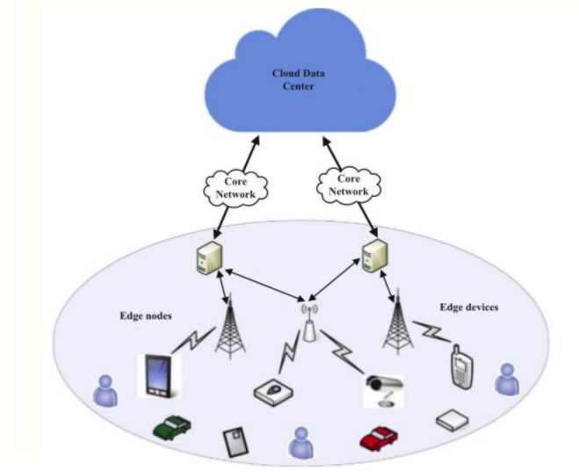
The architecture of edge computing.

Slide 46
Fog Computing
Fog computing is a geographically distributed computing architecture with heterogeneous devices at the edge of network are ubiquitously connected to collaboratively provide elastic computation, communication and storage services
fog computing is the extension of the cloud service to the edge of network which makes computation, communication, control and storage closer to end-users by pooling the local resources

Slide 47
Fog Computing
adds an extra resource-rich layer between end devices and cloud to meet these challenges in the low latency, high reliability and security, high performance, mobility, and interoperability
Fog nodes include various network edge devices and management systems within these devices, even some virtualized edge data centers
bridges the edge users and cloud

Slide 48
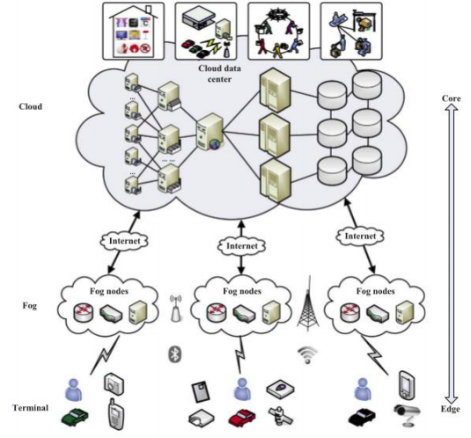
Architecture of fog computing

Slide 49
Fog Computing
Fog nodes connect with end devices and users mainly by wireless connection mode, such as 4G, Bluetooth, or WiFi, to independently provide computing, computation, and storage services
Fog nodes can also be connected with cloud by Internet in order to make full use of the rich computing and storage resources of cloud

Slide 50
Architecture of fog computing

Slide 51
Characteristics of fog computing
Low latency and real time interactions
Save bandwidth
Support for mobility
Geographical distribution and decentralized data analytic
Heterogeneity
Interoperability
Data security and privacy protection
Low energy consumption

Slide 52
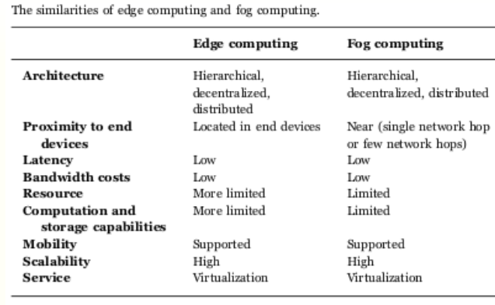

Slide 53
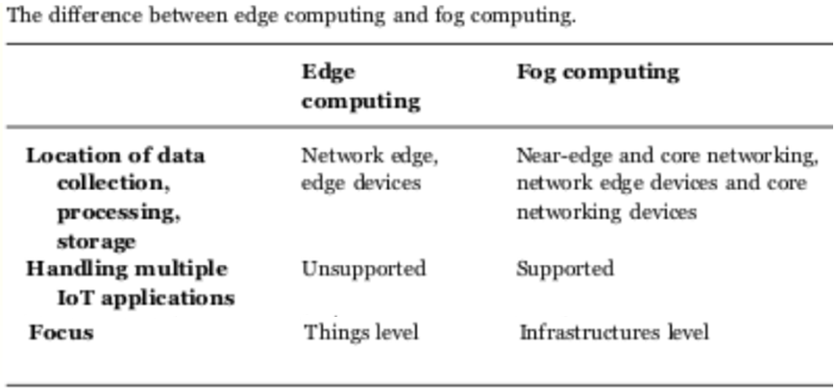

Slide 54
Applications of fog and Edge Computing
Health care: -A wide variety of works about monitoring, detection, diagnosis and visualization of health maladies have been proposed in recent years.
Vehicular fog computing: - Vehicular Fog Computing (VFC) employs vehicles as the infrastructures to make the best use of these vehicular computational and communication resources.

Slide 55


